Slide 1

MSDS610 – DATA ENGINEERING
Data Engineering Fundamentals
Notes:
Notes – Data Engineering Fundamentals
Good [morning/afternoon/evening] everyone!
Today, we’ll explore the fundamentals of Data Engineering, a crucial field that enables organizations to manage and process large-scale data efficiently.
In this session, we’ll cover:
-Pipeline Design
-Data Quality
-Postage SQL Database Work
-Implementation(Jupyter Notebook)
By the end, you’ll have a solid foundation in Data Engineering and its importance in the data-driven world. Let’s get started!

Slide 2

01
Pipeline Design
Notes:
Notes – Pipeline Design
In this section, we’ll discuss Pipeline Design, a crucial aspect of data engineering.
A data pipeline is a set of processes that move and transform data from one system to another efficiently.
Designing an effective pipeline involves considering data sources, processing steps, storage solutions, and real-time vs batch processing.
The goal is to ensure scalability, reliability, and performance while handling large datasets.

Slide 3



Pipeline Diagram
Data Ingestion (Extract)
Data Processing (Transform)
Data Storage (Load)
Data Analysis & Machine Learning
Dashboard & Monitoring
Notes:
Notes - "Pipeline Diagram"
So this slide presents a Pipeline Diagram, outlining the sequential stages of data processing.
We start with Data Ingestion (Extract), where raw data is collected from various sources.
Next is Data Processing (Transform), where the data is cleaned, transformed, and prepared for storage.
The processed data is then moved to Data Storage (Load), where it is securely stored in databases or data warehouses.
After storage, we move to Data Analysis & Machine Learning, where insights are derived, and models are trained to make predictions.
Finally, we reach Dashboard & Monitoring, where the results are visualized, and performance is tracked over time.
This structured pipeline ensures smooth data flow, improving efficiency and decision-making.

Slide 4

Steps
1
Data Ingestion (Extract)
Data Source: Original telco.csv file (or a database with this data)
Tool: Python (Pandas, SQL), Apache Kafka if streaming.
2
Data Processing (Transform)
Cleaning
Fill missing values for Churn Category and Churn Reason are missing.
Make categorical variables the same format. Feature Engineering
Generate new feature Average Monthly Charge: Total Charges / Age.
Convert categorical feature into numerical variables (Gender, Payment Method). Validation
Check for outliers; e.g. Total Charges that is way above the mean.
Verify schema: check that each column has an appropriate data type.
3
Data Storage (Load)
Final storage choices:
Data Warehouse-PostgreSQL/BigQuery/Redshift is used for analytics.
Data Lake-Parquet/Avro-is used for the large-scale model.
Storage: CSV/JSON, in case APIs are utilized.
4
Data Analysis & Machine Learning
Use case: Customer churn prediction.
Decision Trees, Logistic Regression, and Neural Networks in ML.
Utilize Scikit-Learn or TensorFlow or PySpark ML tools
5
Dashboard and Monitoring
The Power BI/ Tableau use visualizations and Automate Alerts on drift in data & schema changes.
Notes:
Notes - "Steps"
This slide provides a step-by-step breakdown of the data pipeline process:
-Data Ingestion (Extract) – This is where we collect raw data, either from a CSV file or a database. We may use tools like Python (Pandas, SQL) or Apache Kafka for streaming data.
-Data Processing (Transform) – This step involves cleaning and feature engineering. We fill in missing values, convert categorical data into numerical values, generate new features, and validate the schema to ensure data integrity.
-Data Storage (Load) – After processing, data is stored efficiently. We use data warehouses like PostgreSQL, BigQuery, or Redshift for analytics, and data lakes like Parquet or Avro for large-scale storage. APIs may also use CSV/JSON formats.
-Data Analysis & Machine Learning – Here, we apply ML techniques for customer churn prediction using algorithms like Decision Trees, Logistic Regression, and Neural Networks, leveraging tools like Scikit-Learn, TensorFlow, or PySpark.
-Dashboard & Monitoring – Finally, insights are visualized using Power BI or Tableau, and automation is implemented to track data drift and schema changes for better monitoring.
This structured approach ensures effective data management and insightful decision-making.

Slide 5

Pipeline Type || Data Format
Why Batch Pipeline?
Why Choose CSV?
1️⃣ Optimized for historical batch analysis (Total Charges, Churn Score trends).
2️⃣ Efficient data transformation (cleaning, feature engineering, validation). 3️⃣ Hybrid approach storage (SQL + Parquet) is scalable. 4️⃣ Supports the training and deployment of ML models for churn prediction. 5️⃣ Easy integration with BI tools such as Power BI/Tableau.
✅ Simple & widely supported (friendly to being opened into Excel, BI tools, or APIs). ✅ Ideal for lightweight data sharing not optimized for large-scale storage.
Notes:
Notes:
"This slide covers our Batch Pipeline and CSV format choices.
Batch Pipeline is ideal for historical analysis, efficient data transformation, scalable storage (SQL + Parquet), ML model training, and seamless BI tool integration.
CSV is simple, widely supported, great for lightweight data sharing, but not ideal for large-scale storage.
This setup ensures efficiency, scalability, and accessibility in our data workflow.

Slide 6
02
Data Quality
Notes:
Notes:
-This section focuses on Data Quality—a key factor in ensuring accurate, reliable, and meaningful insights.
-High-quality data improves decision-making, model performance, and overall business efficiency. Let’s explore its importance and best practices.

Slide 7
Data Quality
Key Issues in the Dataset
1️⃣ Missing Values (e.g., Churn Category, Churn Reason have nulls) 2️⃣ Outliers (e.g., Unusually high Total Charges or Churn Score) 3️⃣ Inconsistent Categorical Variables (e.g., Gender, Payment Method formatting inconsistencies)
Notes:
Notes:
-This slide highlights key data quality issues that can impact analysis and decision-making.
-We focus on missing values, outliers, and inconsistent categorical variables, which can introduce bias and errors. Addressing these ensures data accuracy and reliability.

Slide 8


Validation & Monitoring Plan
✅ Missing Value Handling:
Imply by using mean/median for numerical, mode for categorical.
Drop if the missing rate is too high.
✅ Outlier Detection & Handling:
Use IQR method or Z-score to pick up extreme values.
Use capping or log transformation to make data look more normal.
✅ Categorical Data Standardization
Text should be made into a uniform case (e.g., lowercase) and leading spaces removed.
Apply one-hot encoding or label encoding for ML model.
Notes:
Notes:
-This slide outlines key steps for ensuring data validation and quality monitoring.
-We focus on missing value handling, where we use statistical imputation or drop data if necessary.
-Next, we detect and manage outliers using IQR or Z-score methods to maintain data integrity.
-Finally, we standardize categorical data by ensuring uniform formatting and encoding for machine learning.
-These steps enhance data consistency and reliability."

Slide 9
Detecting Data Drift & Schema Changes
Data Drift & Schema Monitoring Plan:
A presentation refers to a structured communication process in which information, ideas, or concepts are transmitted to an audience. It usually involves the sender of the message and the receiver, in this case, the presenter and the audience, respectively. Presentations can be mainly oral speeches, multimedia slideshows, demonstrations, or interactive sessions.
Schema Change Detection:
Check for unexpected new columns or data types.
Implement automated schema validation scripts to alert mismatches.
Notes:
Notes:
-This slide focuses on detecting data drift and schema changes, which are critical for maintaining data integrity in machine learning models.
-Data drift occurs when incoming data deviates significantly from historical patterns, affecting model performance. We need continuous monitoring to detect such shifts early.
-Schema changes happen when unexpected new columns or data types appear in the dataset. To handle this, we implement automated validation scripts that flag mismatches and ensure consistency.
-By actively monitoring both aspects, we can maintain the reliability of our data pipeline and prevent unexpected failures.

Slide 10
PostgeSQL Database Work (pgAdmin4 UI)
03
Notes:
Speaker Notes:
-This section focuses on PostgreSQL database work using pgAdmin4 UI, a powerful graphical tool for managing and interacting with PostgreSQL databases.

Slide 11
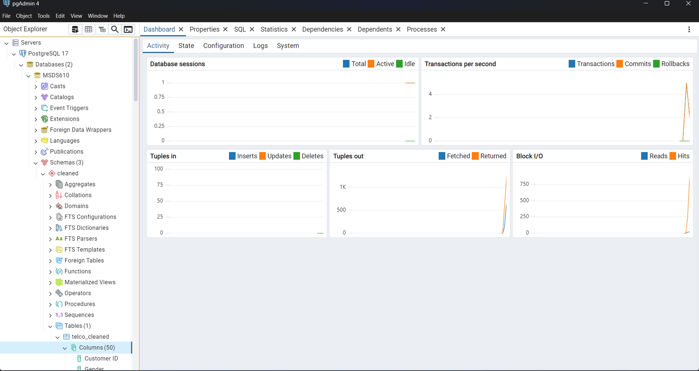
Create a new schema inside your MSDS610 database named ‘cleaned’
Notes:
Notes:
-In this step, we are creating a new schema inside our MSDS610 database, named 'cleaned'.
-A schema is a logical container that helps organize database objects like tables, functions, and views. It allows for better management and segmentation of data.
-To create a new schema in pgAdmin4:
-Navigate to your database MSDS610 in the Object Explorer.
-Right-click on Schemas → Select Create → Schema.
-Enter the name 'cleaned' and click Save.
-This schema will store cleaned and processed data separately from raw data, improving data management and organization.

Slide 12
Implementation (Jupyter Notebook)
04
Notes:
Notes:
-This section focuses on the implementation phase, where we apply the concepts and methodologies in a Jupyter Notebook.
-Jupyter Notebook is an interactive computing environment that allows us to write and execute code, visualize data, and document findings in a structured way.
In this implementation, we will:
-Load and preprocess the dataset.
-Perform exploratory data analysis (EDA).
-Apply transformations and modeling techniques.
-Evaluate and interpret results.

Slide 13

Implementation
1
Data Extraction (SQL Query to Extract Raw Data)
SELECT * FROM telco_data;
Data Transformation (Cleaning & Feature Engineering)
2
1️⃣ Handling Missing Values: Fill Churn Category and
Churn Reason with "Unknown"
2️⃣ Feature Engineering: Create Average Monthly Charges
using (Total Charges / Tenure)
Load Transformed Data
3
SELECT * FROM cleaned.telco_data LIMIT 10;
Notes:
Notes:
"This slide outlines our data preparation process:
1️. Data Extraction: Retrieving raw data using SELECT * FROM telco_data;.
2️. Data Transformation:
-Filling missing churn values with 'Unknown'.
-Creating Average Monthly Charges (Total Charges / Tenure).
3️. Load Transformed Data: Previewing cleaned data with SELECT * FROM cleaned.telco_data LIMIT 10;.
-These steps ensure a clean dataset for further analysis!

Slide 14
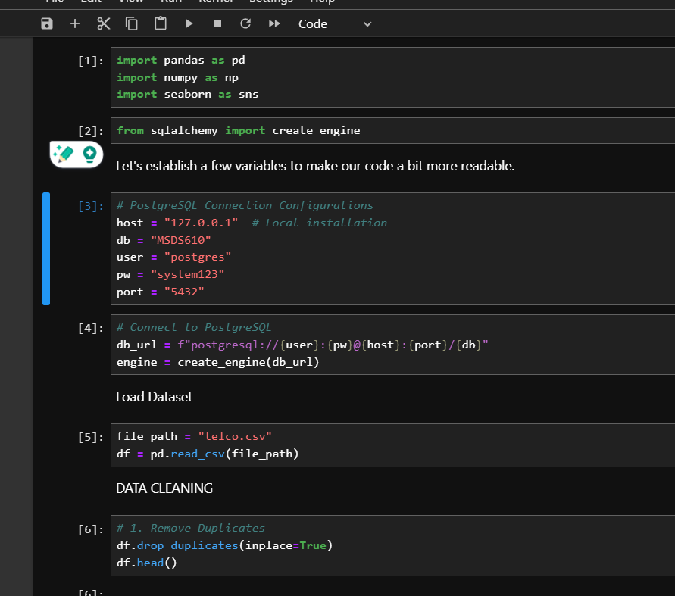
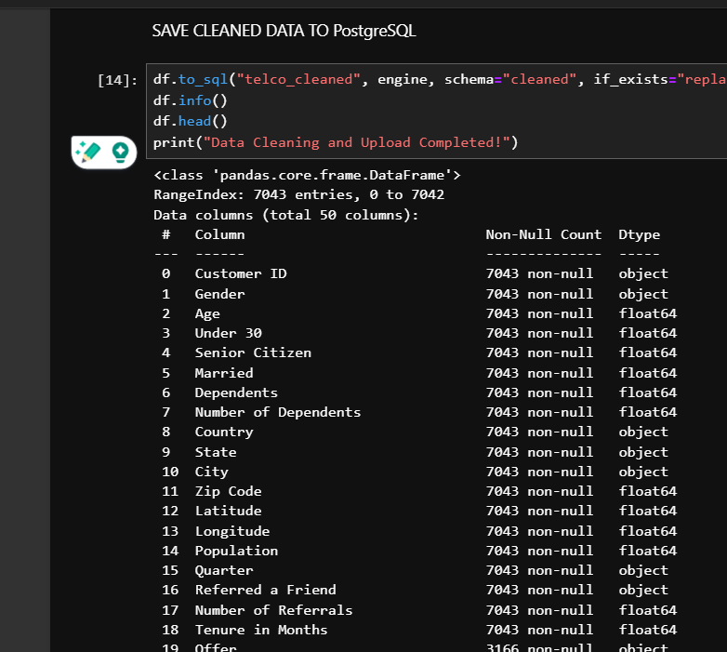
Implementation Screenshots
Notes:
Speaker Notes:
-This slide presents implementation screenshots of our data pipeline.
Left Side: Establishing a PostgreSQL connection, loading the dataset, and performing data cleaning like removing duplicates.
Right Side: Saving the cleaned data to PostgreSQL, checking data integrity using df.info(), and confirming successful upload.
-These steps ensure a structured, clean dataset ready for analysis!

Slide 15

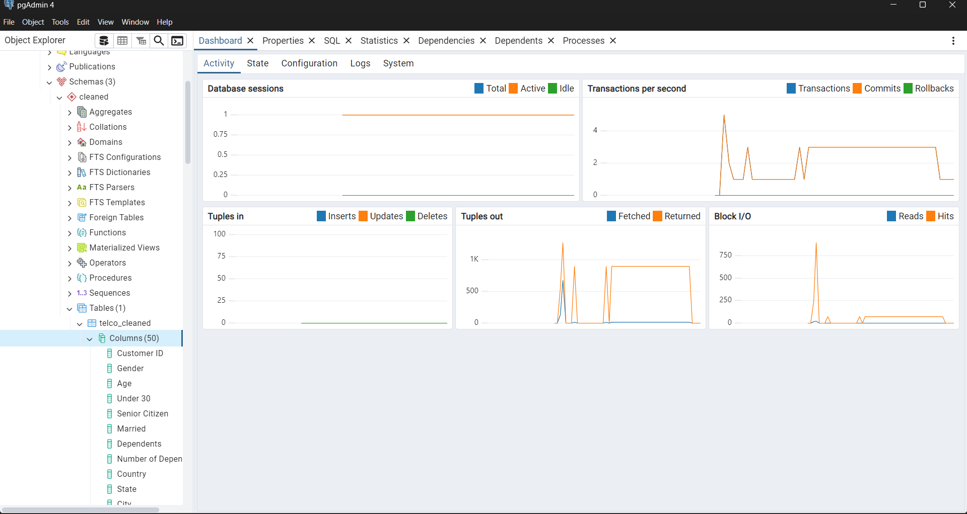

Load Transformed Data Screenshot
Notes:
Notes:
-This slide showcases the successful loading of transformed data into PostgreSQL using pgAdmin.
The left panel confirms that the cleaned dataset, telco_cleaned, is stored under the 'cleaned' schema with 50 columns.
- The right panel displays database activity, showing insert operations, transactions, and system performance metrics like block I/O and tuples processed.
-This validates that our data transformation was successful and is now ready for querying and analysis.

Slide 16

Thank You

